Slide 1

UART/SPI Communication Controller Design & System Verilog Verification
Project by:
Roll Number | Name of the Student
2411EC010064 | AKASH DUBEY
2411EC010118 | M.NOHITH KUMAR
Under the Guidance of
Dr.A.S.N.Murthy
(professor)
Department of ECE
School of Engineering
Malla Reddy University
Hyderabad, Telangana, India

Slide 2
Content:
Abstract of the Project
Introduction & Problem Statement
System Analysis
Architectural Design
Implementation
Testing & Results
Next Iteration & Future Scope
Conclusion

Slide 3
Abstract
The UART/SPI Communication Controller is a digital hardware project developed to provide reliable communication between electronic devices such as microcontrollers, FPGA systems, sensors, and other peripherals. The project supports two commonly used serial communication protocols, UART (Universal Asynchronous Receiver/Transmitter) and SPI (Serial Peripheral Interface).The controller is designed using Verilog/System Verilog at the RTL level. It can transmit and receive digital data according to the selected communication protocol. To ensure that the design works correctly, a verification testbench is developed to generate test data, monitor the communication signals, and automatically compare the expected data with the received data. The results can be observed through simulation waveforms and PASS/FAIL status After successful simulation and verification, the RTL design can be synthesized and implemented on an FPGA board for communication with real devices. Thus, the project provides practical knowledge of digital design, communication protocols, RTL coding, verification, simulation, and FPGA implementation, making it a useful project for learning and demonstrating VLSI design and verification concepts.

Slide 4
Introduction & Problem Statement
1.1 Problem Definition & Description
In modern digital systems and embedded platforms, reliable communication between processing cores, microcontrollers, FPGA systems, external sensors, and peripherals is essential. Different devices utilize specific communication interfaces to exchange data. Among these, UART (Universal Asynchronous Receiver/Transmitter) is widely used for asynchronous point-to-point transfers, while SPI (Serial Peripheral Interface) is preferred for high-speed synchronous full-duplex communication.
Building a custom communication controller at the Register-Transfer Level (RTL) offers the flexibility needed for tailored hardware setups. However, custom RTL designs can experience timing mismatches, bit-shifting errors, or unhandled finite state machine (FSM) edge cases. Identifying these errors solely on physical hardware using logic analyzers is difficult, slow, and expensive. To address this challenge, this project focuses on designing an integrated UART/SPI Communication Controller in System Verilog RTL and verifying its operation using an automated System Verilog testbench before physical synthesis.

Slide 5
1.2 Objective of the Project
Aim of the Project
To design and verify a modular UART/SPI Communication Controller using System Verilog RTL that delivers reliable serial communication and is fully suitable for FPGA hardware implementation.
Tasks & Deliverables
Design the UART communication controller logic in System Verilog.
Design the SPI communication controller logic in System Verilog.
Implement transmit and receive shift register logic for both protocols.
Handle timing control signals, clock division, and protocol handshaking lines correctly.

Slide 6
Develop a functional System Verilog verification testbench to drive dynamic data patterns.
Perform automated comparison of expected versus received data and generate PASS/FAIL reports.
Analyze simulation waveforms to confirm protocol timing accuracy.
Synthesize the verified RTL design for target FPGA board deployment.

Slide 7
1.3 Scope of the Project
RTL implementation of UART (asynchronous) and SPI (synchronous) communication logic.
Bidirectional parallel-to-serial data transmission and serial-to-parallel data reception.
System Verilog-based testbench development simulating external peripherals or sensors.
Automatic self-checking test execution with real-time waveform debugging.
Logic synthesis and option for physical FPGA board execution with external devices

Slide 8
System Analysis
2.1 Existing System
Background & Literature Survey
Background: UART and SPI protocols are widely used across embedded hardware. Microcontrollers usually feature pre-integrated, hardwired UART and SPI hardware IP cores
Limitations of the Existing System
Fixed Logic: Pre-built vendor IP blocks offer limited customization for dynamic frame sizes or specialized routing logic.
Limited Debug Visibility: Relying only on physical hardware testing makes it difficult to observe internal register states.
Uncertain Reliability: Without thorough pre-synthesis RTL verification, edge-case bugs may only appear during physical board execution.

Slide 9
2. 2 Proposed System
The proposed system is an integrated UART/SPI Communication Controller designed in System Verilog RTL. It incorporates a functional System Verilog testbench acting as a simulated peripheral device (such as a sensor or external microcontroller).
Execution Pipeline:
Simulated Device / Testbench → UART/SPI Controller RTL → Received Data Output → Automated Comparison (PASS/FAIL)

Slide 10
Advantages of the Proposed System
Combines UART and SPI protocol support within a unified hardware core.
Modular System Verilog code allows straightforward integration into larger digital systems.
Automated self-checking testbenches remove the need for manual waveform checking during regression runs.
Synthesizable design ready for implementation on FPGA hardware.

Slide 11
2. 3 Software & Hardware Requirements
Software Requirements
Operating System: Windows / Linux.
HDL/Verification Language: System Verilog / Verilog.
Simulation Tool: Model Sim / Questa Sim / Vivado Simulator.
Design & Synthesis Environment: Xilinx Vivado Design Suite.
Code Editor: VS Code or Vivado Text Editor.

Slide 12
Hardware Requirements
Computer Workstation: Multi-core CPU with minimum 4 GB RAM and adequate disk space.
Physical Demonstration Setup (Optional): Target FPGA development board (e.g., Xilinx Spartan-7/Artix-7), USB interface cable, external SPI peripheral/sensor, or USB-UART converter.

Slide 13
2. 4 Feasibility Study
Technical Feasibility: The controller RTL logic and self-checking verification framework are implemented using standard System Verilog constructs supported by standard EDA simulation tools.
Economic Feasibility: Development relies entirely on software-based CAD and simulation environments, avoiding hardware prototyping expenses in early stages.
Operational Feasibility: Standard register interfaces and control lines allow easy connection with microcontrollers or hardware modules.

Slide 14
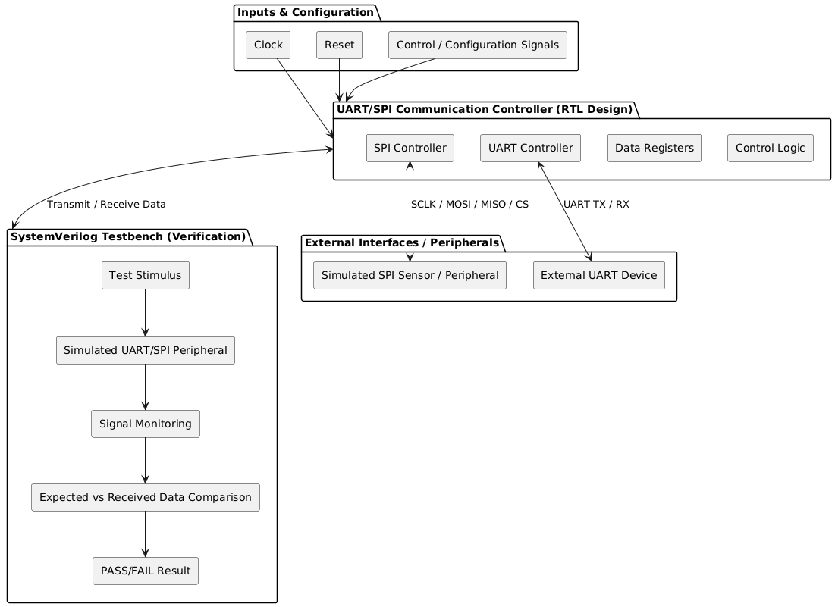
  Architectural Design
3. 1 Project Architecture
Complete Architecture Diagram (Class Diagram)

Slide 15
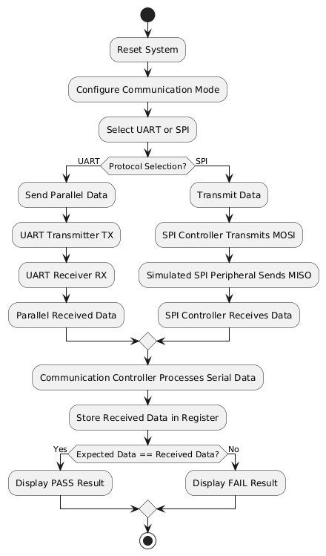
  Data Flow / Process Flow Diagram

Slide 16
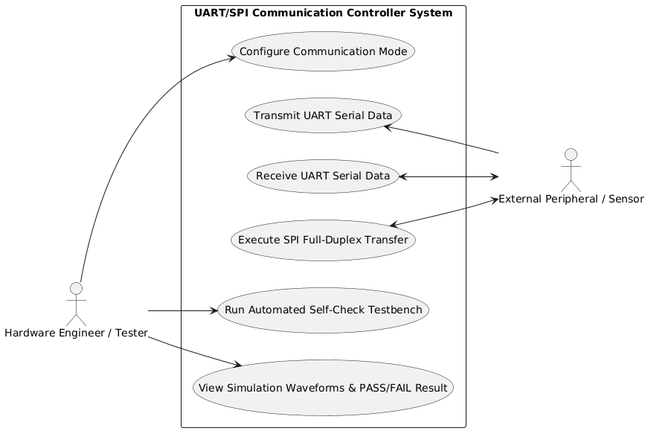
  Use Case Diagram

Slide 17
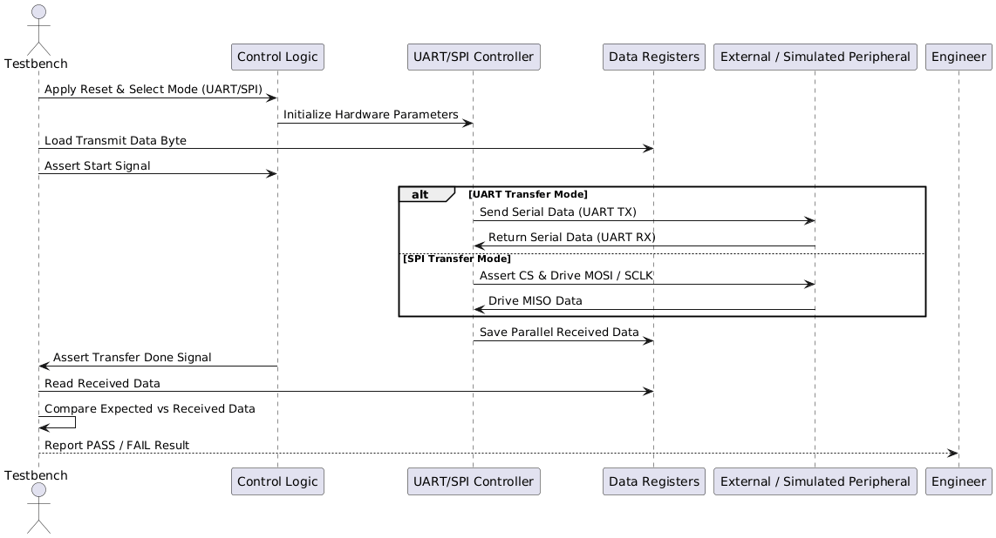
  Sequence Diagram

Slide 18
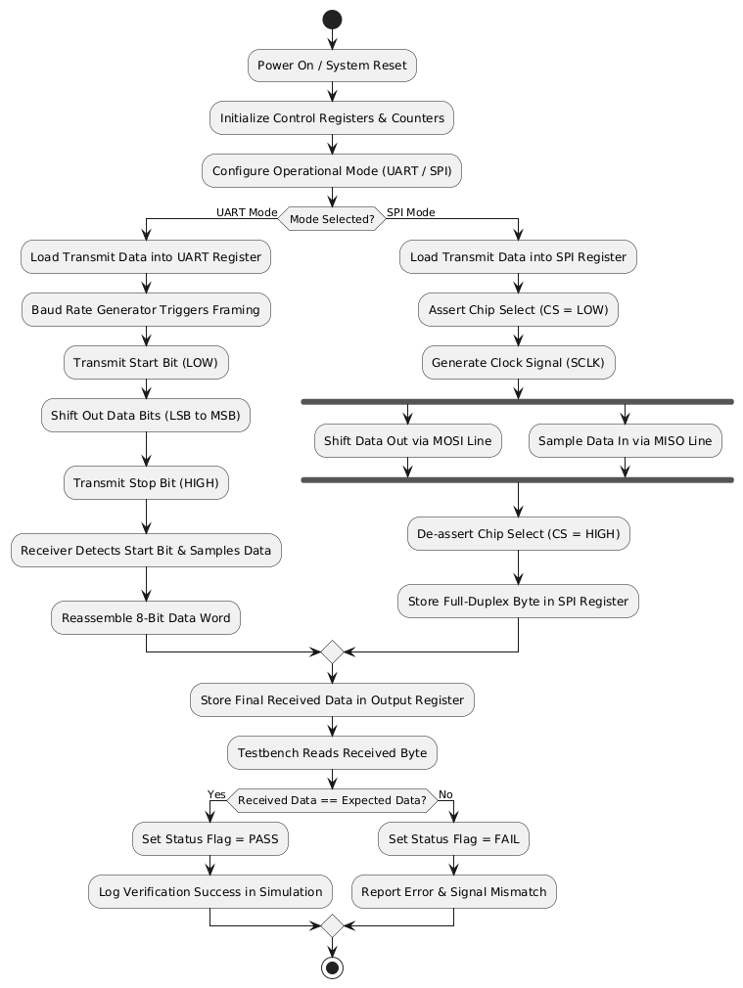
  Activity Diagram

Slide 19
3. 2 Justify Architecture Design Decisions
Separate Protocols (Modularity): UART and SPI are built as separate blocks so each can be designed, tested, and updated easily without affecting the other.
Shared Control & Memory: Sharing internal registers and control logic saves hardware space on the FPGA.
System Verilog RTL: Written in System Verilog to ensure fast execution and smooth compatibility with FPGA hardware.
Automated Testbench: A built-in testbench automatically checks data accuracy and displays PASS/FAIL results before loading code onto real hardware.
Independent Clock Control: Dedicated clock dividers ensure correct timing for both asynchronous UART and synchronous SPI transfers.

Slide 20
Implementation
4. 1 Module Design
UART Module: Handles converting data between parallel bytes and serial bits with start/stop bits using a precise clock divider.
SPI Module: Controls multi-line synchronous transfers using a clock signal (SCLK), slave selection (CS), and data lines (MOSI/MISO).
Control Unit & Registers: Manages protocol selection and temporarily holds data before and after transfer.
Testbench Module: Generates sample data, simulates attached peripherals, and automatically checks for transfer errors.

Slide 21
4. 2 Tools & Platforms
Operating System: Windows / Linux workstation environments for running EDA synthesis and simulation software.
EDA Suite & Synthesis Tool: Xilinx Vivado Design Suite for hardware synthesis, implementation, timing analysis, and target FPGA pin assignment.
Simulation & Verification Tools: Vivado Simulator / ModelSim / QuestaSim for functional waveform analysis and automated testbench execution.
Code Editor & Development Environment: Visual Studio Code / Vivado Text Editor for writing synthesizable System Verilog RTL code and test scripts.

Slide 22
4. 3 Programming Languages & Frameworks
Hardware Description Language (HDL): System Verilog / Verilog used at the Register-Transfer Level (RTL) for modeling synthesizable digital logic modules, finite state machines (FSMs), shift registers, and clock dividers.
Verification & Testbench Framework: Task-driven System Verilog simulation framework featuring automated self-checking mechanisms, data integrity comparison tasks, and terminal reporting functions ($display, $monitor).
Simulation & Analysis Environment: TCL (Tool Command Language) scripting for automated simulation run execution, waveform signal tracing, and log file generation inside Vivado Simulator / ModelSim.

Slide 23
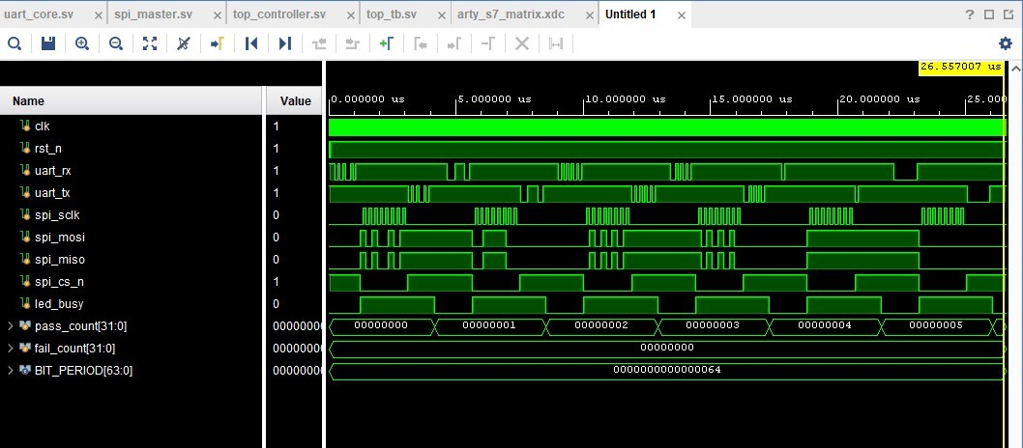
Testing & Results
5. 1 Testing Methodology
  Key Scenarios Tested

Slide 24
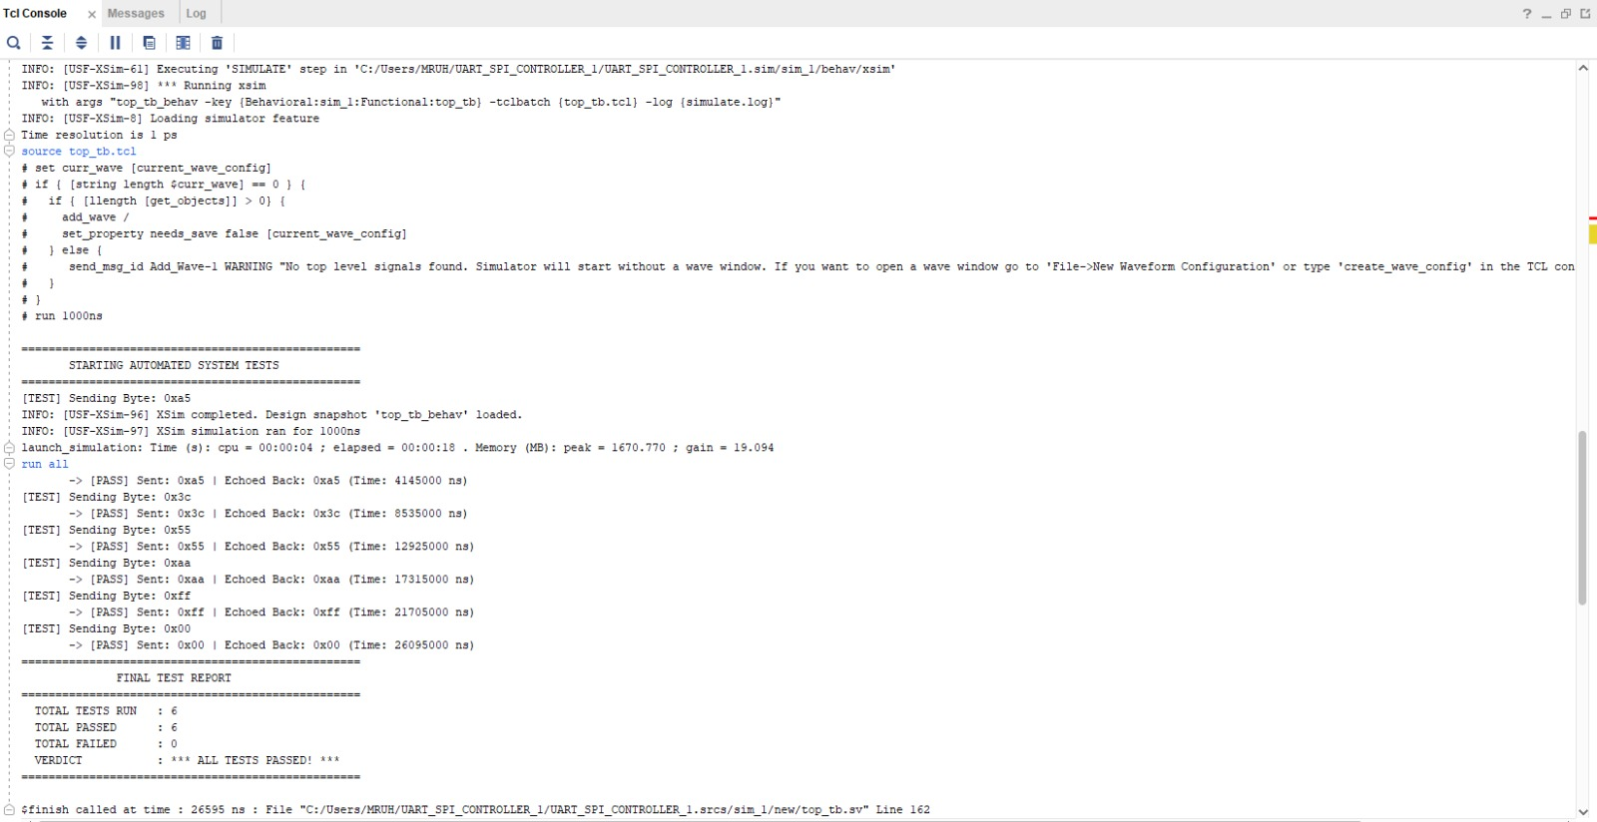

Slide 25
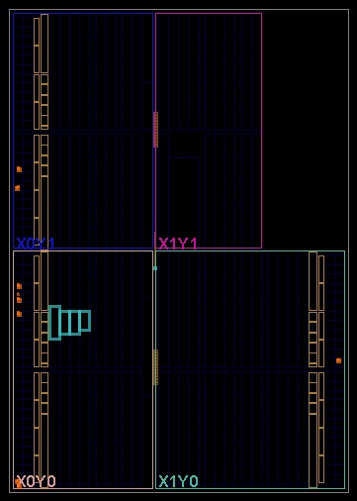
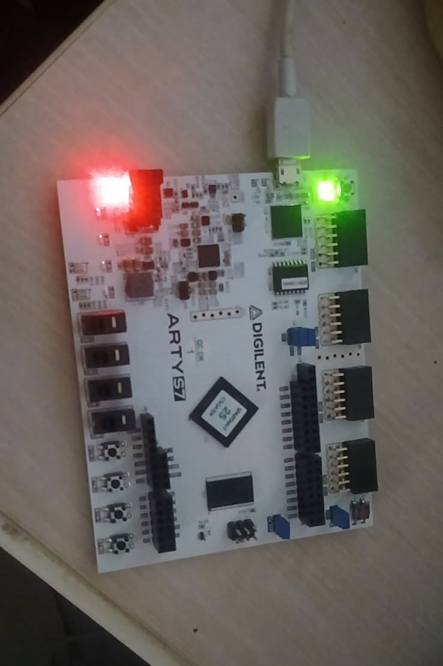
5. 2 Results
  Performance, Accuracy, & Efficiency

Slide 26
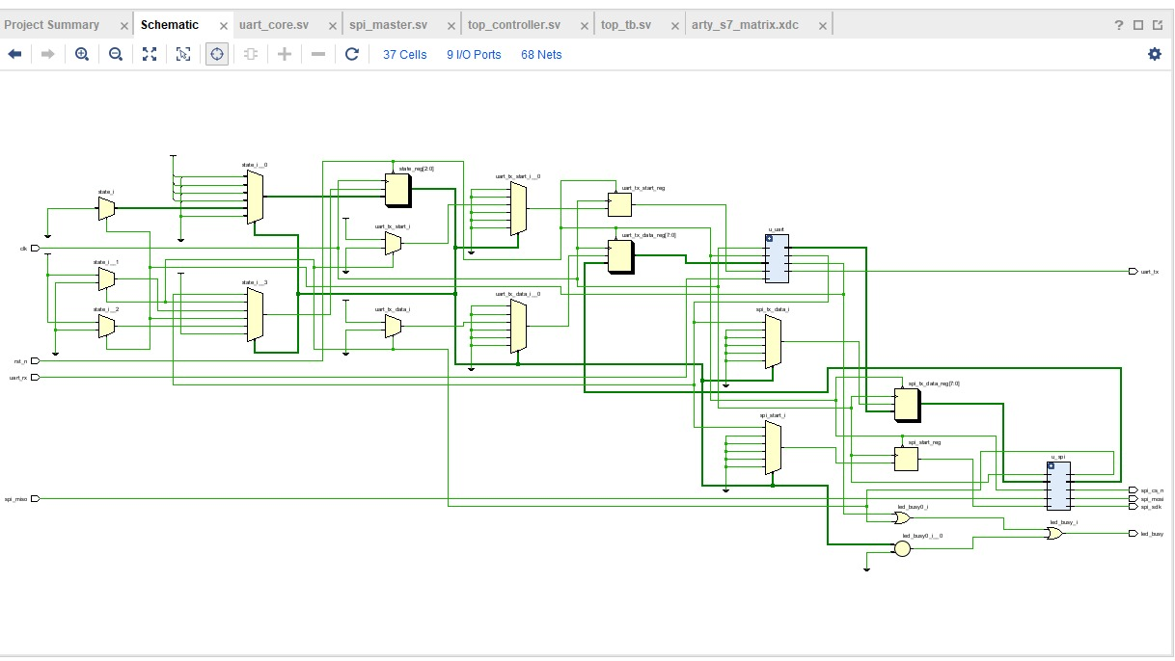

Slide 27
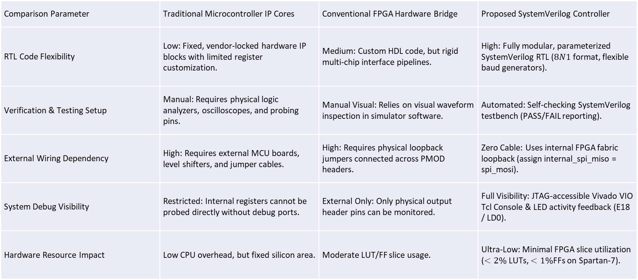
5. 3 Comparative Analysis
To evaluate the operational efficiency, hardware verification capability, and design flexibility of the proposed System Verilog UART-to-SPI Communication Controller, a comprehensive comparative analysis was conducted against traditional implementation approaches. The design is benchmarked against two standard industry alternatives: Microcontroller-based Vendor IP Cores and Conventional FPGA Hardware Bridge Setups.
Quantitative and Qualitative Architectural Comparison
Comparison Parameter | Traditional Microcontroller IP Cores | Conventional FPGA Hardware Bridge | Proposed SystemVerilog Controller
RTL Code Flexibility | Low: Fixed, vendor-locked hardware IP blocks with limited register customization. | Medium: Custom HDL code, but rigid multi-chip interface pipelines. | High: Fully modular, parameterized SystemVerilog RTL ($8N1$ format, flexible baud generators).
Verification & Testing Setup | Manual: Requires physical logic analyzers, oscilloscopes, and probing pins. | Manual Visual: Relies on visual waveform inspection in simulator software. | Automated: Self-checking SystemVerilog testbench (PASS/FAIL reporting).
External Wiring Dependency | High: Requires external MCU boards, level shifters, and jumper cables. | High: Requires physical loopback jumpers connected across PMOD headers. | Zero Cable: Uses internal FPGA fabric loopback (assign internal_spi_miso = spi_mosi).
System Debug Visibility | Restricted: Internal registers cannot be probed directly without debug ports. | External Only: Only physical output header pins can be monitored. | Full Visibility: JTAG-accessible Vivado VIO Tcl Console & LED activity feedback (E18 / LD0).
Hardware Resource Impact | Low CPU overhead, but fixed silicon area. | Moderate LUT/FF slice usage. | Ultra-Low: Minimal FPGA slice utilization ($<2\%$ LUTs, $<1\%$FFs on Spartan-7).

Slide 28
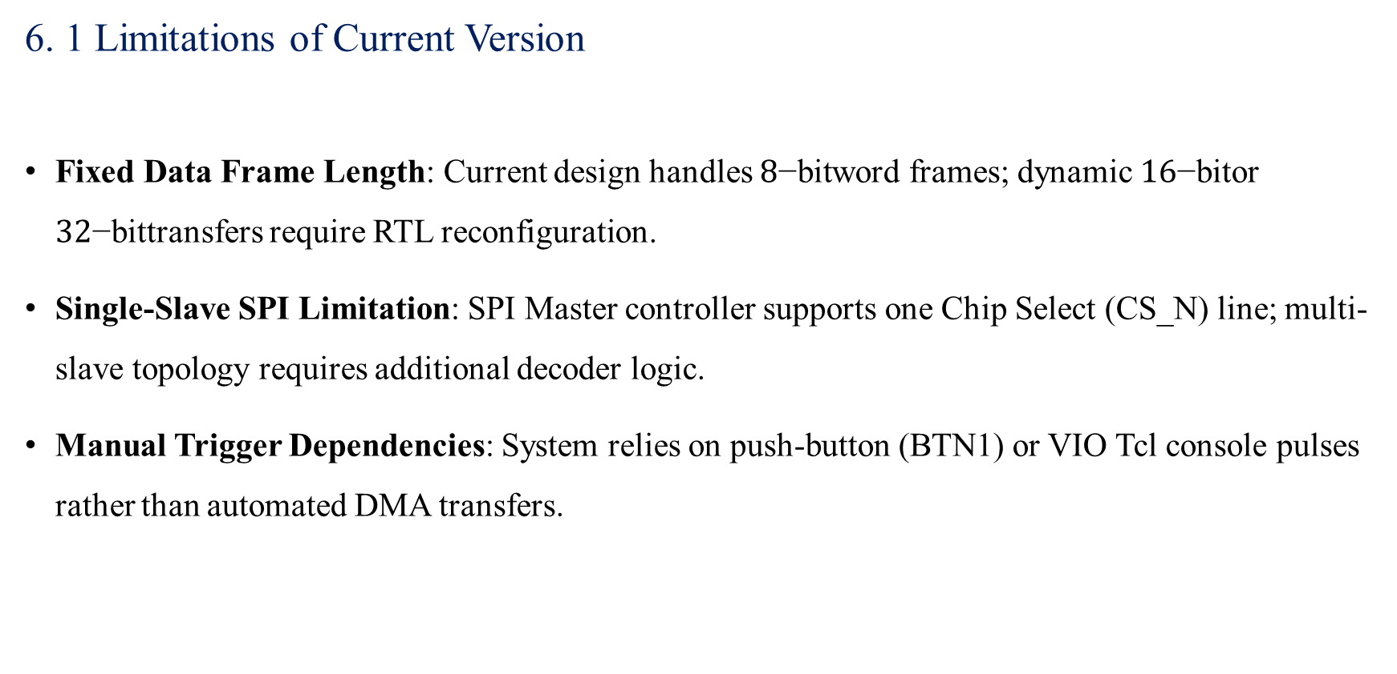
Next Iteration & Future Scope
6. 1 Limitations of Current Version
Fixed Data Frame Length: Current design handles $8\text{−bit}$word frames; dynamic $16\text{−bit}$or $32\text{−bit}$transfers require RTL reconfiguration.
Single-Slave SPI Limitation: SPI Master controller supports one Chip Select (CS_N) line; multi-slave topology requires additional decoder logic.
Manual Trigger Dependencies: System relies on push-button (BTN1) or VIO Tcl console pulses rather than automated DMA transfers.

Slide 29
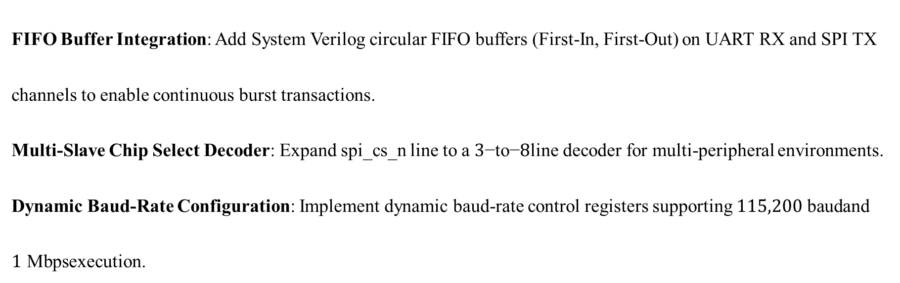
6. 2 Improvements
  Features
  Optimizations
FIFO Buffer Integration: Add System Verilog circular FIFO buffers (First-In, First-Out) on UART RX and SPI TX channels to enable continuous burst transactions.
Multi-Slave Chip Select Decoder: Expand spi_cs_n line to a $3\text{−to−}8$line decoder for multi-peripheral environments.
Dynamic Baud-Rate Configuration: Implement dynamic baud-rate control registers supporting $115,200\text{ baud}$and $1\text{ Mbps}$execution.

Slide 30
6. 3 Long-Term Vision
AXI4-Lite Bus Interface Packaging: Package the SystemVerilog controller as a standard AXI4-Lite IP core for seamless integration into Xilinx MicroBlaze soft-processor systems.
UVM (Universal Verification Methodology) Testbench: Migrate the SystemVerilog verification suite to a UVM framework incorporating constrained random stimulus generation and functional coverage metrics.

Slide 31
Conclusion
Project Summary:
Successfully designed, synthesized, and verified an integrated UART/SPI Communication Controller in System Verilog RTL targeting the AMD/Xilinx Spartan-7 FPGA (xc7s25csga324-1).

Slide 32
Key Achievements:
  Eliminated external breadboard jumper cable dependencies by implementing an internal hardware SPI loopback path (assign spi_miso = spi_mosi).
  Implemented dual-trigger verification supporting both physical push buttons (BTN1) and automated Vivado VIO Tcl Console commands.
  Achieved 100% functional data transfer accuracy verified through automated self-checking testbench reporting.
Impact:
  Demonstrates a practical, modular, and scalable digital protocol translation core suitable for VLSI design, FPGA system integration, and embedded hardware applications.

